Slide 1

Artificial Intelligence
Agents and Environments
CS-632
Dr. Muhammad Aqib
University Institute of Information Technology
PMAS-Arid Agriculture University Rawalpindi

Slide 2

Agent Definition
"An agent is anything that can be viewed as perceiving its environment through sensors and acting upon that environment through effectors."
Russell & Norvig

Slide 3
Agents & Environments
The agent takes sensory input from its environment and produces as output actions that affect it.
sensor
input
action
output
Agent
Environment

Slide 4
Intelligent Agent [Terziyan, 1993]
is goal-oriented, because it should have at least one goal - to keep continuously balance between its internal and external environments ;
is creative because of the ability to change external environment;
is adaptive because of the ability to change internal environment;
is mobile because of the ability to move to another place;
is social because of the ability to communicate to create a community;
is self-configurable because of the ability to protect “mental health” by sensing only a “suitable” part of the environment.

Slide 5
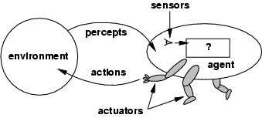
Agents Function MaP
The agent function maps from percept histories to actions:

Slide 6
Agents Examples
Human agent:
eyes, ears, and other organs for sensors;
hands, legs, mouth, and other body parts for actuators
Robotic agent:
cameras and infrared range finders for sensors
various motors for actuators

Slide 7
PEAS
Use PEAS to describe task environment
Performance measure
Environment
Actuators
Sensors
Example: Taxi driver
Performance measure: safe, fast, comfortable (maximize profits)
Environment: roads, other traffic, pedestrians, customers
Actuators: steering, accelerator, brake, signal, horn
Sensors: cameras, sonar, speedometer, GPS, odometer, accelerometer, engine sensors

Slide 8
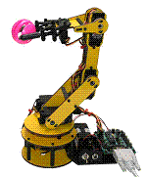
PEAS
Agent: Part-picking robot
Performance measure: Percentage of parts in correct bins
Environment: Conveyor belt with parts, bins
Actuators: Jointed arm and hand
Sensors: Camera, joint angle sensors

Slide 9
PEAS
Agent: Medical diagnosis system
Performance measure: Healthy patient, minimize costs
Environment: Patient, hospital, staff
Actuators: Screen display (questions, tests, diagnoses, treatments, referrals)
Sensors: Keyboard (entry of symptoms, findings, patient's answers)

Slide 10
PEAS
Agent: Interactive English tutor
Performance measure: Maximize student's score on test
Environment: Set of students
Actuators: Screen display (exercises, suggestions, corrections)
Sensors: Keyboard

Slide 11
Environments
Actions are done by the agent on the environment.
Environment provides percepts to the agent.
Determine to a large degree the interaction between the “outside world” and the agent
the “outside world” is not necessarily the “real world” as we perceive it
it may be a real or virtual environment the agent lives in
In many cases, environments are implemented within computers
They may or may not have a close correspondence to the “real world”

Slide 12
Properties of environments
Fully observable vs. partially observable or Accessible vs. inaccessible
If an agent’s sensory equipment gives it access to the complete state of the environment, then we say that environment is fully observable to the agent.
An environment is effectively fully observable if the sensors detect all aspects that are relevant to the choice of action.
A fully observable environment is convenient because the agent need not maintain any internal state to keep track of the world.

Slide 13
Properties of environments
Deterministic vs nondeterministic
If the next state of the environment is completely determined by the current state and the actions selected by the agents, then we say the environment is deterministic.
Strategic: the environment is deterministic except for the actions of other agents
If the environment is inaccessible, then it may appear to be nondeterministic (bunch of uncertainties) Also know as stochastic.

Slide 14
Properties of environments
Episodic vs. sequential.
Agent’s experience is divided into “episodes.”
Each episode consists of the agent perceiving and acting.
Subsequent episodes do not depend on the actions in the previous episodes. Episodic environments are much simpler because the agent does not need to think ahead
In sequential environments current actions affect all succeeding actions

Slide 15
Properties of environments
Static vs. Dynamic
If the environment can change while an agent is performing action, then we say the environment is dynamic otherwise, it is static.
Static environments are easy to deal with, because the agent does not keep on looking at the environment while it is deciding on an action.
Semi dynamic: If the environment does not change with the passage of time but the agent performance score does.

Slide 16
Properties of environments
Discrete vs. continuous
If there are a limited number of distinct, clearly defined percepts and actions, we say that the environment is discrete.
Chess, since there are a fixed number of possible moves on each turn.
Taxi driving is continuous.

Slide 17
Properties of environments
Single Agent vs. Multi-Agent
In the single agent environment, there is only one agent.
A computer software playing crossword puzzle.
In multiagent systems, there are more than one active agents
Video games

Slide 18
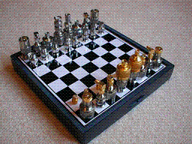
Environment Examples
Environment | Observable | Deterministic | Episodic | Static | Discrete | Agents
Chess with a clock
Chess without a clock
Fully observable vs. partially observable
Deterministic vs. stochastic / strategic
Episodic vs. sequential
Static vs. dynamic
Discrete vs. continuous
Single agent vs. multiagent

Slide 19
Properties of environments
Environment | Observable | Deterministic | Episodic | Static | Discrete | Agents
Chess | Fully | Strategic | Sequential | Static | Discrete | Multi
Fully observable vs. partially observable
Deterministic vs. stochastic / strategic
Episodic vs. sequential
Static vs. dynamic
Discrete vs. continuous
Single agent vs. multiagent

Slide 20

Properties of environments
Environment | Observable | Deterministic | Episodic | Static | Discrete | Agents
Chess | Fully | Strategic | Sequential | Static | Discrete | Multi
Poker
Fully observable vs. partially observable
Deterministic vs. stochastic / strategic
Episodic vs. sequential
Static vs. dynamic
Discrete vs. continuous
Single agent vs. multiagent

Slide 21
Properties of environments
Environment | Observable | Deterministic | Episodic | Static | Discrete | Agents
Chess | Fully | Strategic | Sequential | Static | Discrete | Multi
Poker | Partial | Strategic | Sequential | Static | Discrete | Multi
Fully observable vs. partially observable
Deterministic vs. stochastic / strategic
Episodic vs. sequential
Static vs. dynamic
Discrete vs. continuous
Single agent vs. multiagent

Slide 22
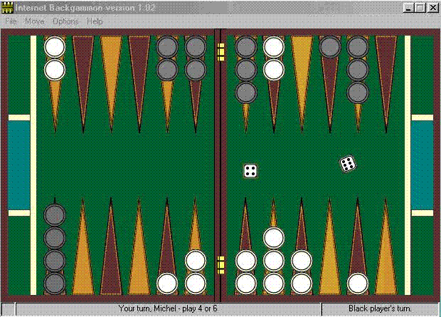
Properties of environments
Environment | Observable | Deterministic | Episodic | Static | Discrete | Agents
Chess with a clock | Fully | Strategic | Sequential | Semi | Discrete | Multi
Chess without a clock | Fully | Strategic | Sequential | Static | Discrete | Multi
Poker | Partial | Strategic | Sequential | Static | Discrete | Multi
Backgammon | Fully | Stochastic | Sequential | Static | Discrete | Multi
Fully observable vs. partially observable
Deterministic vs. stochastic / strategic
Episodic vs. sequential
Static vs. dynamic
Discrete vs. continuous
Single agent vs. multiagent

Slide 23
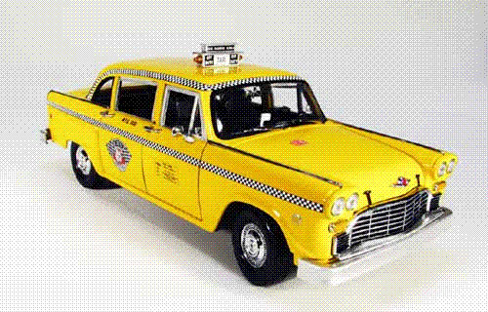
Properties of environments
Environment | Observable | Deterministic | Episodic | Static | Discrete | Agents
Chess with a clock | Fully | Strategic | Sequential | Semi | Discrete | Multi
Chess without a clock | Fully | Strategic | Sequential | Static | Discrete | Multi
Poker | Partial | Strategic | Sequential | Static | Discrete | Multi
Backgammon | Fully | Stochastic | Sequential | Static | Discrete | Multi
Taxi driving | Partial | Stochastic | Sequential | Dynamic | Continuous | Multi
Fully observable vs. partially observable
Deterministic vs. stochastic / strategic
Episodic vs. sequential
Static vs. dynamic
Discrete vs. continuous
Single agent vs. multiagent

Slide 24

Properties of environments
Environment | Observable | Deterministic | Episodic | Static | Discrete | Agents
Chess with a clock | Fully | Strategic | Sequential | Semi | Discrete | Multi
Chess without a clock | Fully | Strategic | Sequential | Static | Discrete | Multi
Poker | Partial | Strategic | Sequential | Static | Discrete | Multi
Backgammon | Fully | Stochastic | Sequential | Static | Discrete | Multi
Taxi driving | Partial | Stochastic | Sequential | Dynamic | Continuous | Multi
Medical diagnosis
Fully observable vs. partially observable
Deterministic vs. stochastic / strategic
Episodic vs. sequential
Static vs. dynamic
Discrete vs. continuous
Single agent vs. multiagent

Slide 25
Properties of environments
Environment | Observable | Deterministic | Episodic | Static | Discrete | Agents
Chess with a clock | Fully | Strategic | Sequential | Semi | Discrete | Multi
Chess without a clock | Fully | Strategic | Sequential | Static | Discrete | Multi
Poker | Partial | Strategic | Sequential | Static | Discrete | Multi
Backgammon | Fully | Stochastic | Sequential | Static | Discrete | Multi
Taxi driving | Partial | Stochastic | Sequential | Dynamic | Continuous | Multi
Medical diagnosis | Partial | Stochastic | Episodic | Static | Continuous | Single
Fully observable vs. partially observable
Deterministic vs. stochastic / strategic
Episodic vs. sequential
Static vs. dynamic
Discrete vs. continuous
Single agent vs. multiagent

Slide 26
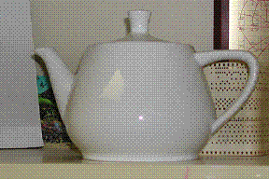
Properties of environments
Environment | Observable | Deterministic | Episodic | Static | Discrete | Agents
Chess with a clock | Fully | Strategic | Sequential | Semi | Discrete | Multi
Chess without a clock | Fully | Strategic | Sequential | Static | Discrete | Multi
Poker | Partial | Strategic | Sequential | Static | Discrete | Multi
Backgammon | Fully | Stochastic | Sequential | Static | Discrete | Multi
Taxi driving | Partial | Stochastic | Sequential | Dynamic | Continuous | Multi
Medical diagnosis | Partial | Stochastic | Episodic | Static | Continuous | Single
Image analysis

Slide 27
Properties of environments
Environment | Observable | Deterministic | Episodic | Static | Discrete | Agents
Chess with a clock | Fully | Strategic | Sequential | Semi | Discrete | Multi
Chess without a clock | Fully | Strategic | Sequential | Static | Discrete | Multi
Poker | Partial | Strategic | Sequential | Static | Discrete | Multi
Backgammon | Fully | Stochastic | Sequential | Static | Discrete | Multi
Taxi driving | Partial | Stochastic | Sequential | Dynamic | Continuous | Multi
Medical diagnosis | Partial | Stochastic | Episodic | Static | Continuous | Single
Image analysis | Fully | Deterministic | Episodic | Semi | Discrete | Single

Slide 28
Properties of environments
Environment | Observable | Deterministic | Episodic | Static | Discrete | Agents
Chess with a clock | Fully | Strategic | Sequential | Semi | Discrete | Multi
Chess without a clock | Fully | Strategic | Sequential | Static | Discrete | Multi
Poker | Partial | Strategic | Sequential | Static | Discrete | Multi
Backgammon | Fully | Stochastic | Sequential | Static | Discrete | Multi
Taxi driving | Partial | Stochastic | Sequential | Dynamic | Continuous | Multi
Medical diagnosis | Partial | Stochastic | Episodic | Static | Continuous | Single
Image analysis | Fully | Deterministic | Episodic | Semi | Discrete | Single
Robot part picking

Slide 29
Properties of environments
Environment | Observable | Deterministic | Episodic | Static | Discrete | Agents
Chess with a clock | Fully | Strategic | Sequential | Semi | Discrete | Multi
Chess without a clock | Fully | Strategic | Sequential | Static | Discrete | Multi
Poker | Partial | Strategic | Sequential | Static | Discrete | Multi
Backgammon | Fully | Stochastic | Sequential | Static | Discrete | Multi
Taxi driving | Partial | Stochastic | Sequential | Dynamic | Continuous | Multi
Medical diagnosis | Partial | Stochastic | Episodic | Static | Continuous | Single
Image analysis | Fully | Deterministic | Episodic | Semi | Discrete | Single
Robot part picking | Fully | Deterministic | Episodic | Semi | Discrete | Single

Slide 30
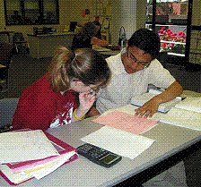
Properties of environments
Environment | Observable | Deterministic | Episodic | Static | Discrete | Agents
Chess with a clock | Fully | Strategic | Sequential | Semi | Discrete | Multi
Chess without a clock | Fully | Strategic | Sequential | Static | Discrete | Multi
Poker | Partial | Strategic | Sequential | Static | Discrete | Multi
Backgammon | Fully | Stochastic | Sequential | Static | Discrete | Multi
Taxi driving | Partial | Stochastic | Sequential | Dynamic | Continuous | Multi
Medical diagnosis | Partial | Stochastic | Episodic | Static | Continuous | Single
Image analysis | Fully | Deterministic | Episodic | Semi | Discrete | Single
Robot part picking | Fully | Deterministic | Episodic | Semi | Discrete | Single
Interactive English tutor

Slide 31
Properties of environments
Environment | Observable | Deterministic | Episodic | Static | Discrete | Agents
Chess with a clock | Fully | Strategic | Sequential | Semi | Discrete | Multi
Chess without a clock | Fully | Strategic | Sequential | Static | Discrete | Multi
Poker | Partial | Strategic | Sequential | Static | Discrete | Multi
Backgammon | Fully | Stochastic | Sequential | Static | Discrete | Multi
Taxi driving | Partial | Stochastic | Sequential | Dynamic | Continuous | Multi
Medical diagnosis | Partial | Stochastic | Episodic | Static | Continuous | Single
Image analysis | Fully | Deterministic | Episodic | Semi | Discrete | Single
Robot part picking | Fully | Deterministic | Episodic | Semi | Discrete | Single
Interactive English tutor | Partial | Stochastic | Sequential | Dynamic | Discrete | Multi

Slide 32
Agent types
Four basic types in order of increasing generalization:
Simple reflex agents
Reflex agents with state/model
Goal-based agents
Utility-based agents

Slide 33
Simple reflex agent
Instead of specifying individual mappings in an explicit table, common input-output associations are recorded
Requires processing of percepts to achieve some abstraction
Method of specification is condition-action rules
if percept then action
If car-in-front-is-braking then initiate-braking
Similar to innate reflexes or learned responses in humans
Efficient implementation, but limited power
Environment must be fully observable
Easily runs into infinite loops

Slide 34
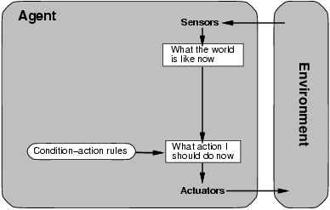
Simple reflex agent

Slide 35
Simple reflex agent
Works by finding a rule whose condition matches the current situation and then doing the action associated with that rule

Slide 36
reflex agent with state/model
Evan a little bit of un-observability can cause serious trouble.
The braking rule given earlier assumes that the condition car-in-front-is-braking can be determined from the current percept – the current video image.
More advanced techniques would require the maintenance of some kind of internal state to choose an action.

Slide 37
reflex agent with state/model
An internal state maintains important information from previous percepts
Sensors only provide a partial picture of the environment
Helps with some partially observable environments
The internal states reflects the agent’s knowledge about the world
This knowledge is called a model
May contain information about changes in the world

Slide 38
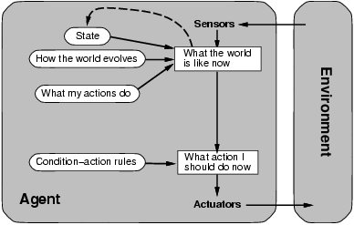
reflex agent with state/model

Slide 39
Goal based agent
Goal-based agents are far more flexible.
If it starts to rain, the agent adjusts itself to the changed circumstances, since it also looks at the way its actions would affect its goals (remember doing the right thing).
For the reflex agent, we would have to rewrite a large number of condition-action rules.

Slide 40
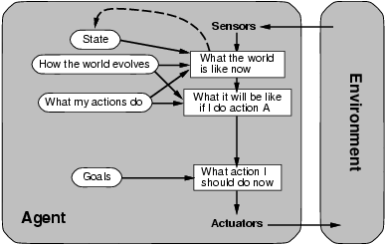
Goal based agent

Slide 41
utility based agent
Goals are not really enough to generate high-quality behavior.
There are many ways to reach the destination, but some are qualitatively better than others.
More safe
Shorter
Less expensive

Slide 42
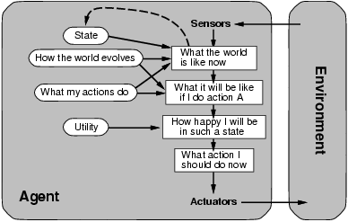
utility based agent

Slide 43
Summery of Today’s Lecture
Types of Environments
Agents Examples based on Environment
Agent types
Simple reflex agents
Reflex agents with state/model
Goal-based agents
Utility-based agents

Slide 44
Thank You

